Slide 1
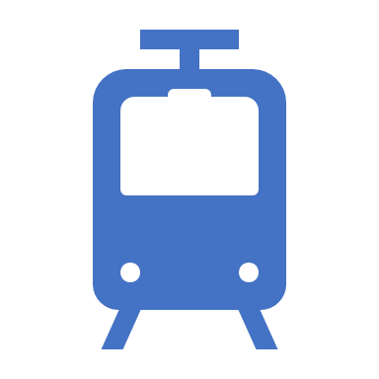
Railways Management
System
Rajat Saxena (2000290140097)
Ritik Srivastava (2000290140104)
Chandresh Gangwar (2000290140037)

Slide 2
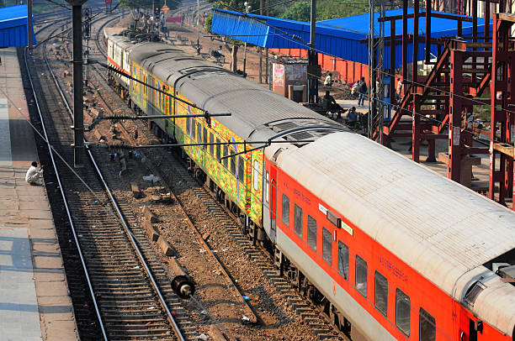
INDIAN RAILWAYS – A SUNRISE INDUSTRY
Railways in India, a sunrise industry!
Indian Railways, a super ‘ Navaratna’.
The Indian Railways (IR) is a truly great institution. It is a global giant that operates profitably, effectively and with relatively little government support.

Slide 3
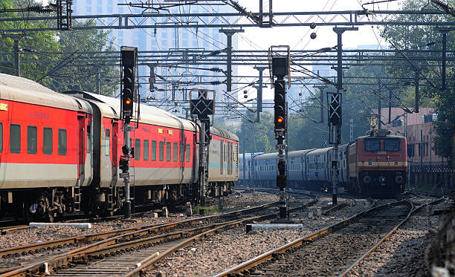
Introduction
The Railways Management System is basically concerned with Train details Scheduling System like:
Train Number
Train Name
Arrival Time
Departure Time
Source
Destination

Slide 4
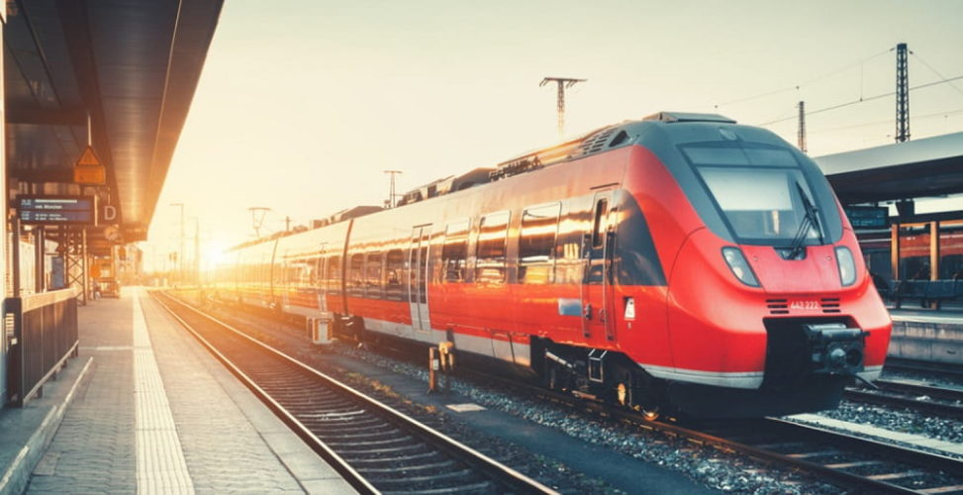
Modules Of Railway Management system
Customer Module: Show train details in table format. Train details are like:
Train Number
Train Name
Arrival Time
Departure Time
Source
Destination

Slide 5
Modules Of Railway Management system
Admin Module:
Admin Authentication
Add Train Details
Update Train Details
Delete train Details
Show Train Details

Slide 6

Technologies used in Train Management System
HTML & CSS(Front End)
Java (Eclipse)
JSP(Java Server Page)
Servlet (Request & Response)
Data Base (My SQL)

Slide 7
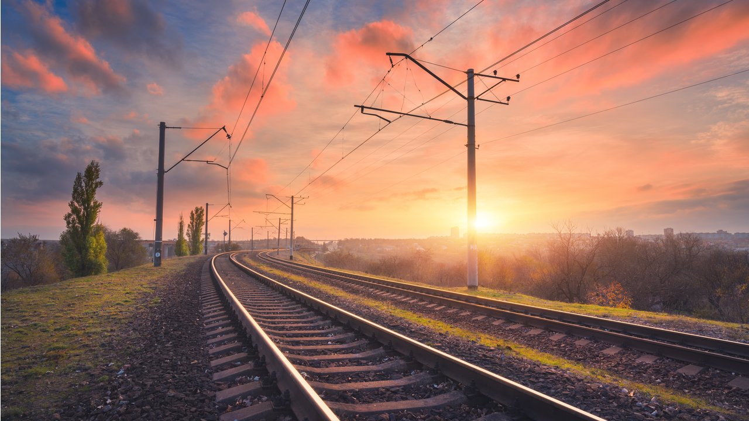
Feature of Railway Management System
User Can Search details of the trains.
User can see the Train Timetable.
Railway Management System is a web-based project by which admin can edit, add, delete and update the record of Timetable ,Trains, Fare.

Slide 8
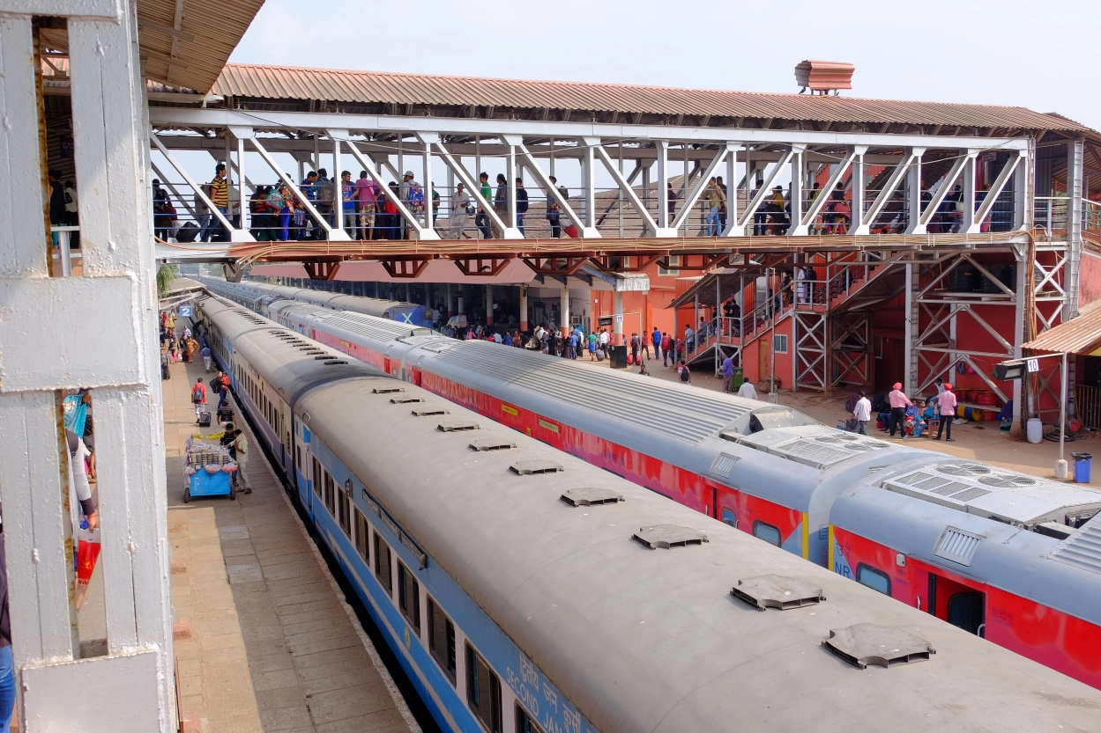
Scope of the project Railway Reservation System
Our project aims is that we have tried to computerize various processes of Railway Reservation System.
It satisfy the user requirement
Be easy to understand by the user and operator.
Be easy to operate.
Have a good user interface.

Slide 9
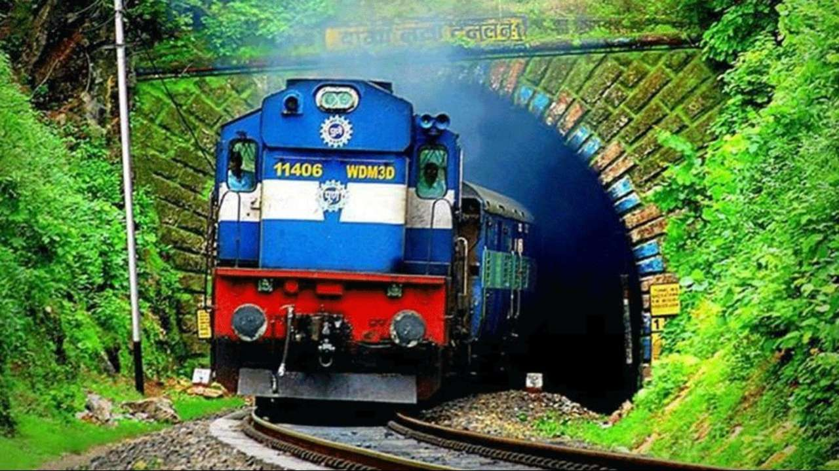
Objective of Project on Railway Reservation System
The main objective of the Project on Railway Reservation System is to manage the details of Train.
The project is totally built at administrative end and thus only the administrator is guaranteed the access.
User can see the train details only.
It tracks all the details about the

Slide 10
